Slide 1
Final Design Package
Compressor Subsystem
University of Pennsylvania Hyperloop Team

Slide 2
University of Pennsylvania Hyperloop Team
Mission Statement:
“We are a small team of Penn Engineering students who are designing the compressor subsystem for the Hyperloop pod. Through this competition, we gained hands-on experience of real world mechanical design, and the challenges associated with it.”
Team Objective:
To design a robust Axial Compressor with a pressure ratio of 20:1 capable of performing efficiently in the low pressure Hyperloop environment, when traveling at near mach speeds.

Slide 3
Team Members
Faculty Advisor: Dr. Mark Yim - Professor and Director of Integrated Product Design
Team:
Krish Mehta - Sophomore; Mechanical Engineering
Anirudh Kaushik - 1st Year Masters student; Mechanical Engineering
Anirudh Subramanyam - 1st Year Masters student; Mechanical Engineering
Jalaj Maheshwari - 1st Year Masters student; Mechanical Engineering
Madhura Gurjar - 2nd Year Masters student; Mechanical Engineering
Stephen Michalowski - Junior; Mechanical Engineering
Mazin Blaik - Junior; Mechanical Engineering
Kellen Sanna - Junior; Mechanical Engineering
Dan Harris - Junior; Mechanical Engineering
Nikhil Chari - Sophomore; Mechanical Engineering, Economics

Slide 4
Why are we designing the Axial Compressor?
An efficient compressor is integral for the pod: necessary for the air cushions, propulsion system, and overall operational efficiency
Commercial Axial Compressors are not built to be efficient with high velocities airflows of near 1 mach and so it presents a unique problem
It is a challenging problem that will really test us.

Slide 5
Theoretical Performance and Characteristics
Overall pressure change - 20:1
Pressure ratio: 1.208 per stage
Mass flow rate: 0.49kg/s
Radius of Compressor: 0.502m
Length of Compressor: 1.52m
Power Consumption: 296kW
Efficiency: 0.81
De Haller’s number: 0.737
Temperature change: 559K
Diffusion Factor: 0.5
Degree of Reaction: 0.5

Slide 6
Manufacturing Specifications
Materials used: 304 Steel
RPM: 6000
Safety Factor: 1.9
Mass of compressor: 700 kg
Estimated Cost: 175,000

Slide 7
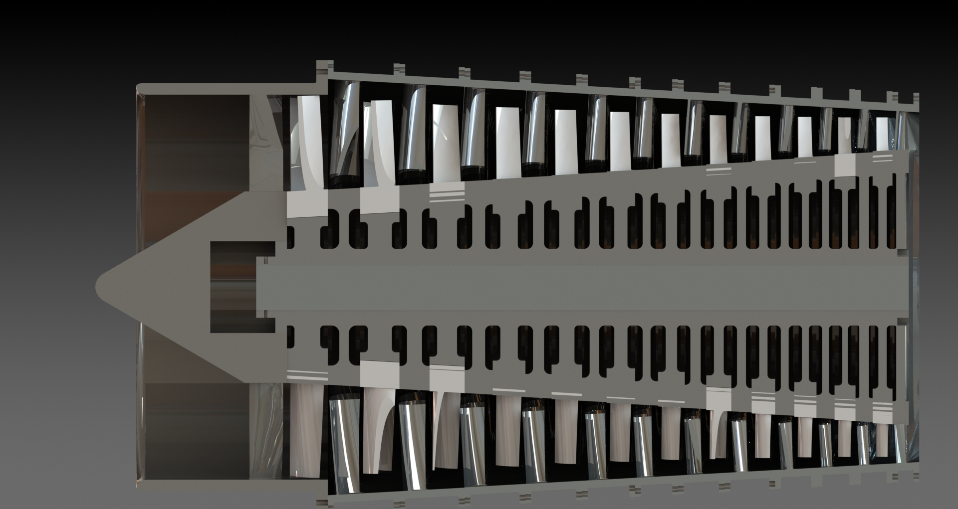
Our Axial Compressor

Slide 8
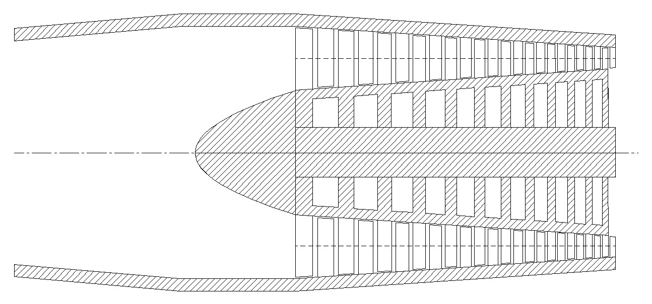
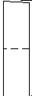
Overall Compressor and Challenges
Stator
Outer Wall
Diffuser
Hub
Nose
Axle
Rotor
Sketch of our Compressor

Slide 9
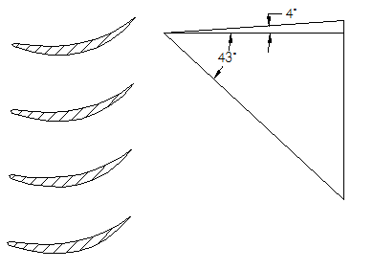
Designing the Guide Vane
We designed the guide vane to deflect the incoming air
The incoming air was too fast; near the tip the air reaches over mach velocity
In order to prevent this, the guide vanes were twisted such that the axial component of the air near the tip of the rotor reduced
Blade angles for the guide vane were chosen to ensure that velocity is fast enough while being sub-sonic
238 m/s
Guide Vane
Velocity triangles between guide vane and the first rotor

Slide 10
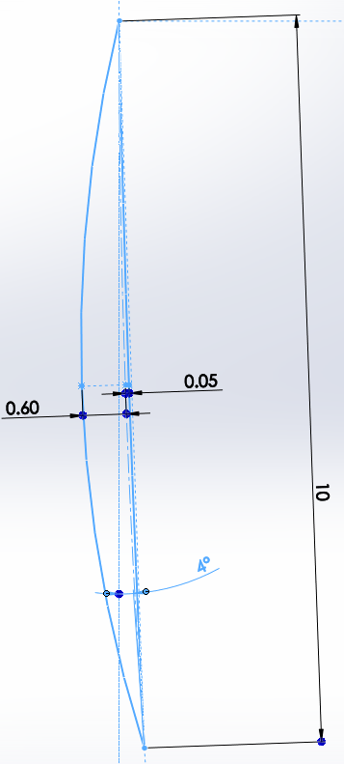
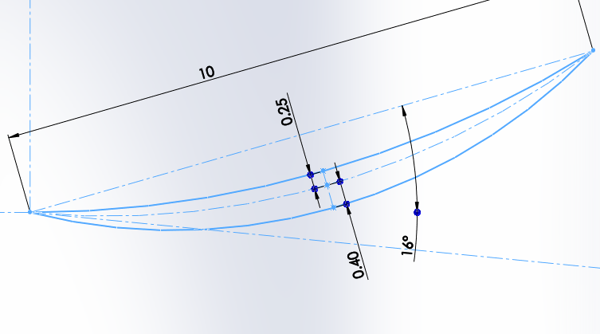
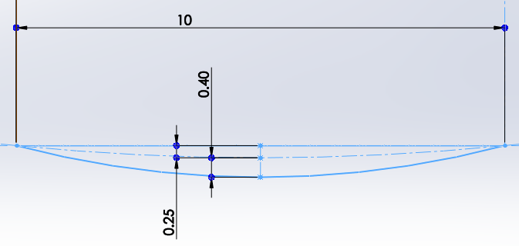
Guide Vane - Airfoil Profiles
Hub
Mid
Tip
As seen in the airfoils, the tip is distinctly more twisted than the mid or the hub

Slide 11
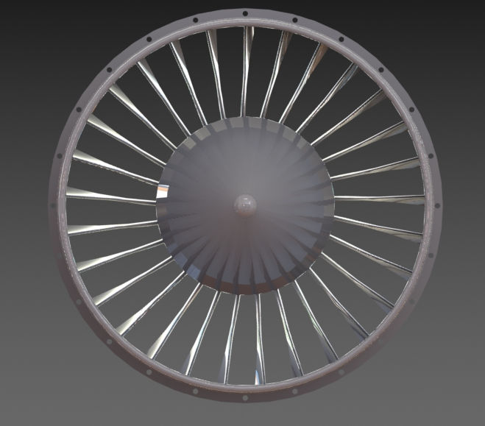
Guide Vane
Guide vane

Slide 12
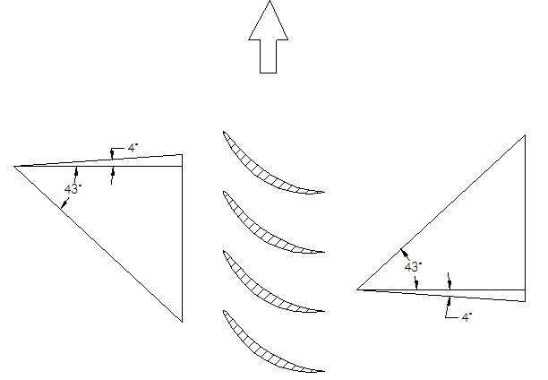
Designing the Rotor
The rotor angles were calculated based on the velocity of the incoming air
To ensure the highest compression ratio, we optimized the blade to have the highest possible De Haller’s number while ensuring subsonic wind velocities at all parts of the Rotor
6000 rpm
238m/s
237m/s
323m/s
323m/s
237m/s
238m/s
Velocity triangles used to calculate the Rotor airfoil angles at the midspan

Slide 13
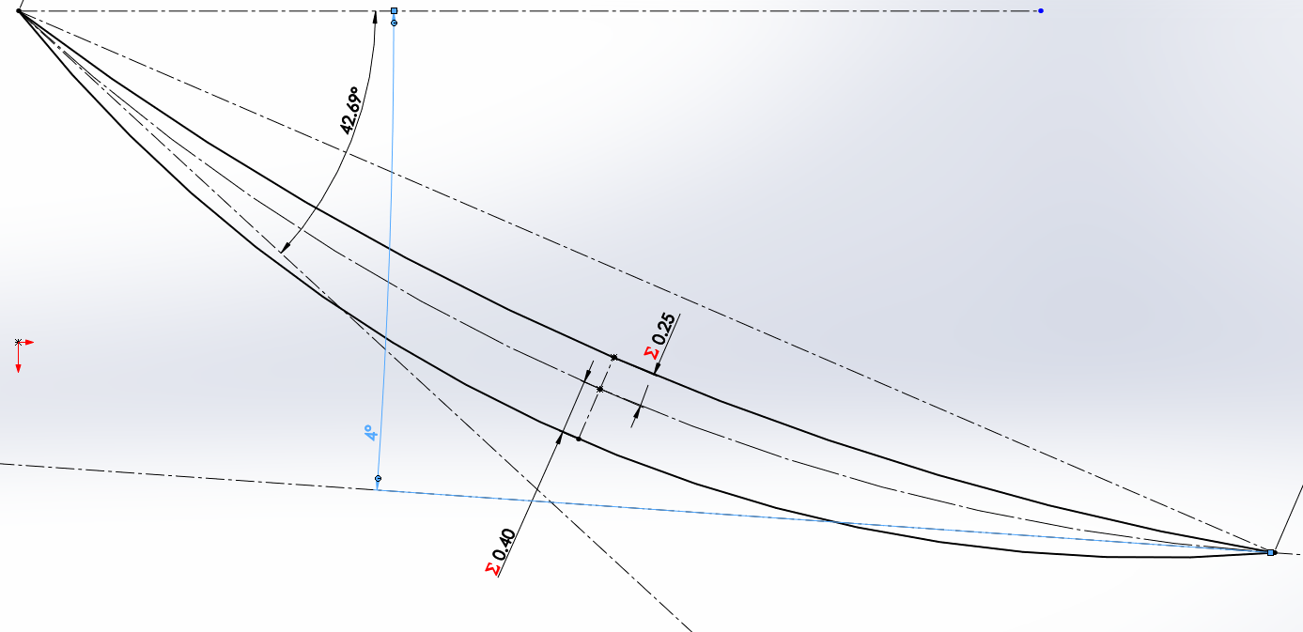
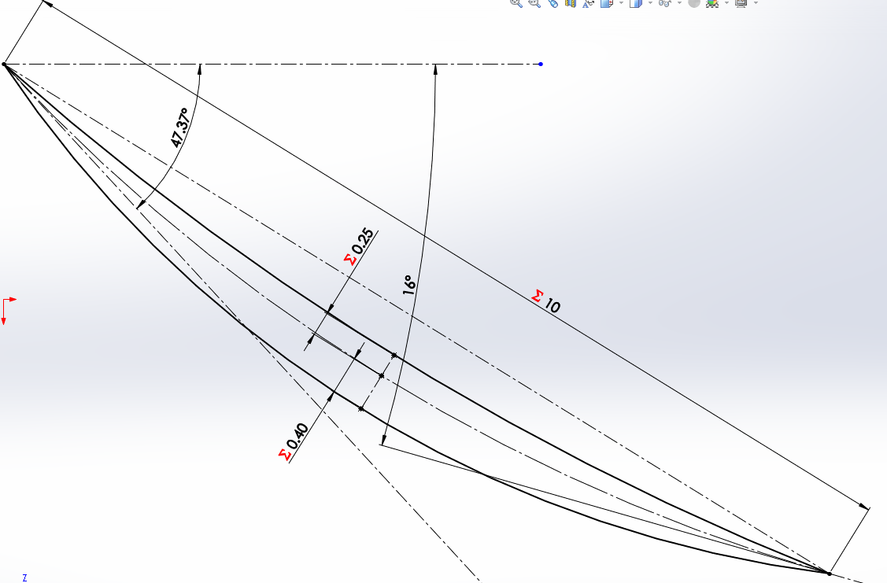
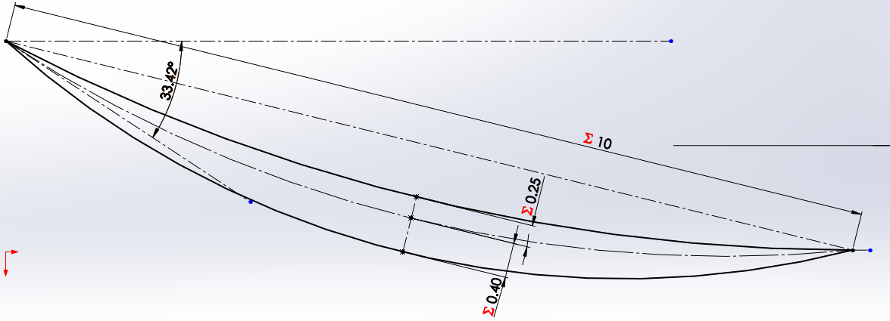
Rotor Airfoil Profiles
Hub
Mid
Tip
To ensure the highest possible De Haller’s number, the blade has to twist at different parts.

Slide 14


Rotor: Blade and Blade root
The rotor blade was designed keeping in mind a tip clearance of 2% of the blade height
The blade root was made into a ‘fir tree’ shape to ensure best pressure distribution and to easily allow the blades to be inserted into the rotor without the blades flying out
Rotor Blade
Rotor Blade Root

Slide 15
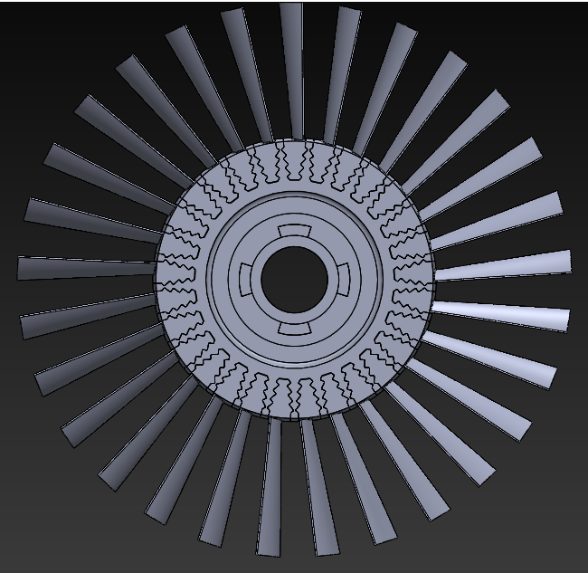

Rotor: First Stage
First stage Rotor
Rotor Disk: Jagged spaces to allow
the blades to cleanly be press-fit in.

Slide 16
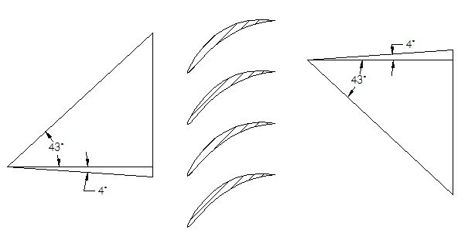
Designing the Stator
The purpose of the stator is:
To realign the airflow so that each rotor receives the same inlet airflow
Blade angles of the stator are designed based on the inlet airflow to the rotor
To increase the pressure ratio by slowing down the velocity of the air
Velocity triangles used to calculate the Stator airfoil angles

Slide 17
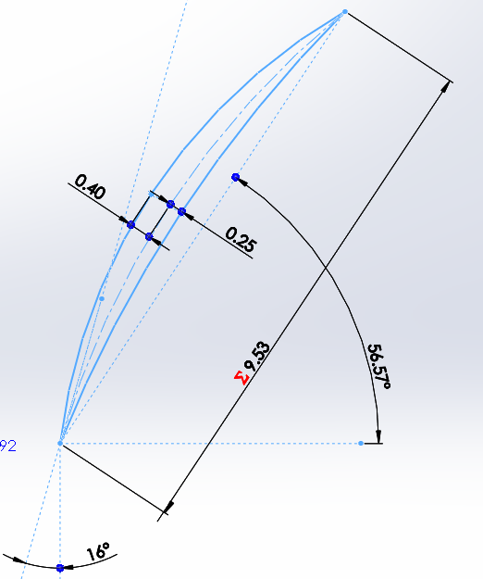
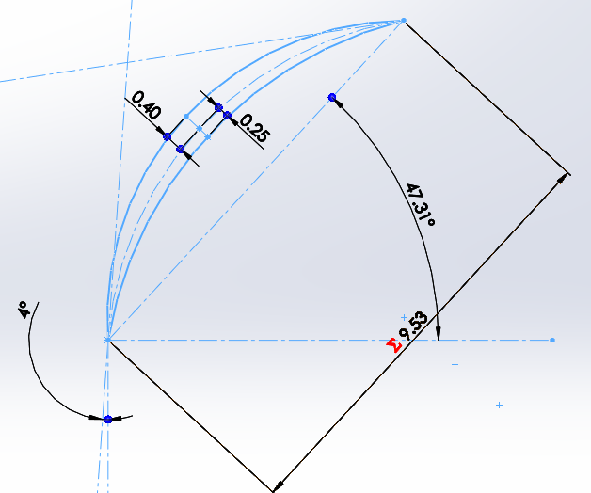
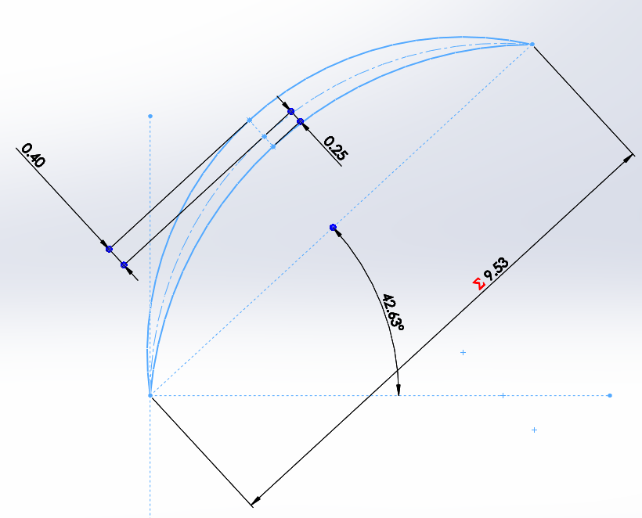
Stator Airfoil Profile
Hub
Mid
Tip

Slide 18
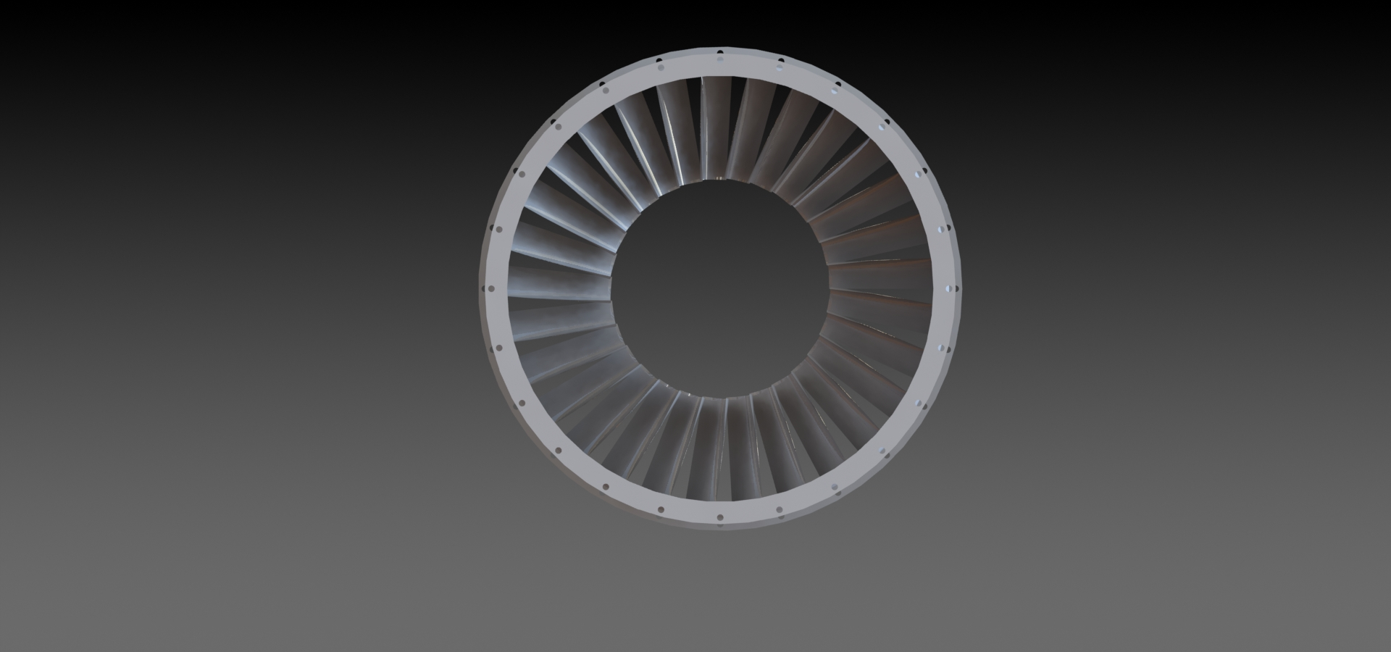

Stator: First Stage
Stator: First stage
Section View

Slide 19
Designing the compressor
The compressor was designed to ensure that the midspan of the blade was consistently the same distance away from the axle. This is to so that the velocity at the midspan remains constant. This is important because pressure ratio is typically found from the meanline.
Midspan
Ensuring midspan of blades is at an even distance from axle

Slide 20
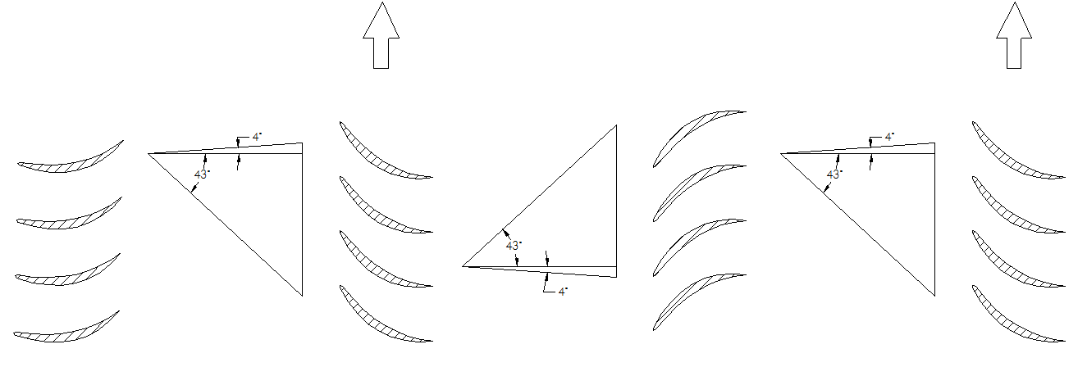
Illustration of Midspan Velocity triangles
235.6m/s
235.6m/s
238m/s
238m/s
237m/s
323m/s
237m/s
323m/s
237m/s
323m/s
238m/s
Guide Vane
Rotor
Stator
Rotor

Slide 21
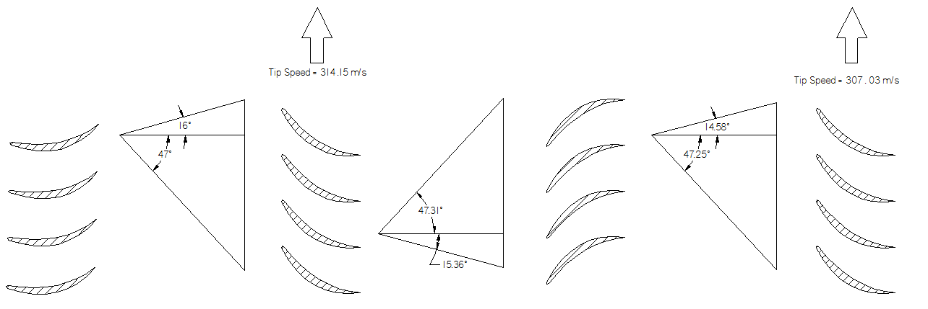
Blade angles for Multiple Stages
Assumption: The absolute exit velocity after each rotor is the absolute entry velocity for the subsequent stator and vice versa. The velocities at the tip for each rotor blade change due to the tapering of the wall and the axle.
Guide Vane
Rotor
Stator
Rotor
Velocity triangles for tip of blades

Slide 22
Multiple stages specifications
Solidity: 1.32
Axle - taper: 3.11 degrees
Outer wall - taper: 3.19 degrees
Aspect ratio: 2.5
Distance between each stage: 2.28cm

Slide 23
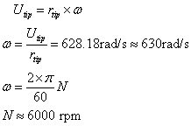
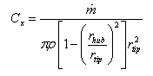
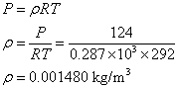
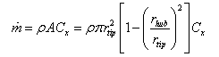
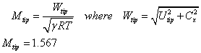
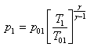
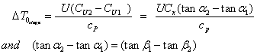
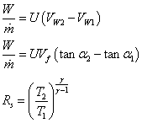
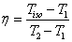
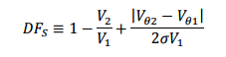
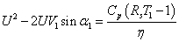
Important Relevant Equations
Ideal gas law
Mass Flow Rate
Angular Velocity
Axial Velocity
Isentropic Expansion
Euler’s Turbine Equation
Work - Power and derived equations
Carnot’s efficiency
Diffusion Factor with respect to velocity triangles
Our derived equation relating tangential velocity to alpha 1

Slide 24
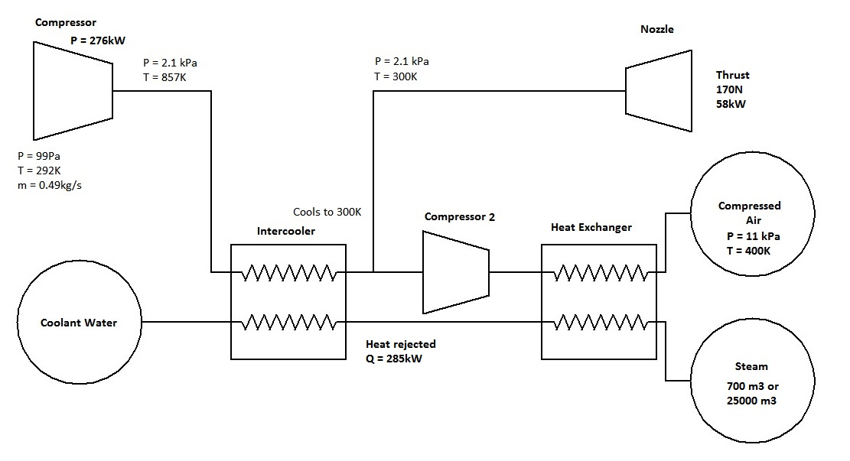
Compressor Schematic in Alpha
T=125K

Slide 25
Rationale behind rejection of schematic in Alpha
In the Alpha paper, the heat rejected at the intercooler → Q = 285kW > the power supplied to the compressor
At the exit of the nozzle, the air would be -148°C; this would imply that the heat absorbed by the water would amount to superheated 650m³ steam at 220°C (the equivalent of covering a football field with steam 1m high)

Slide 26
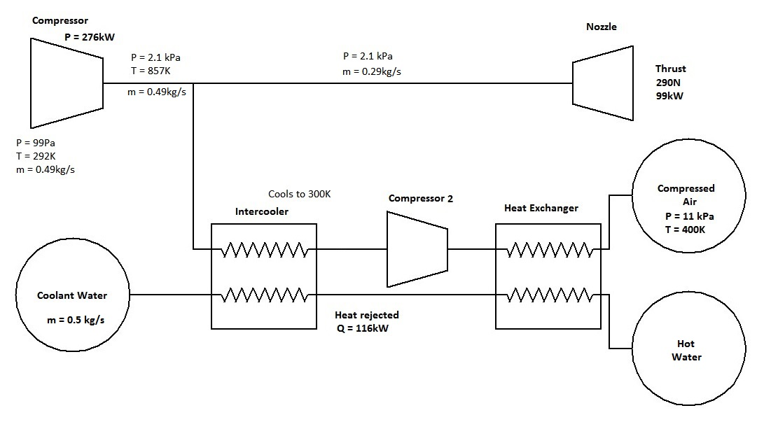
Compressor Schematic Proposed
T=358K

Slide 27
Rationale behind proposed schematic
In the new schematic, the cooling load is halved due to air bleeding directly into the compressor (Q = 116kW)
The reduction in size of the intercooler would offset the use of water
Additionally, thrust generated will now see a 70% increase to 290N and the outlet temperature will be 85°C, a much lower thermal gradient

Slide 28
Safety First
Blade root design allows for better stress distribution
Choice of materials
Low Compressor RPM results in lower stresses
Moderate temperature rise per stage
New design completely eliminates steam generation in intercooler, making thermal handling of the pod much easier and safer
Also ensures the nozzle exhaust temperature is in acceptable range

Slide 29
Thank you for your time
Special thanks to:
Professor Yim and the ModLab
The Mechanical Engineering and Applied Mechanics Department at the University of Pennsylvania

Slide 31
Works Cited
"The Jet Engine." Rolls-Royce. 5th Edition ed. Vol. 1. Rolls Royce Technical Publications, 1996. Print.
"Jet Engine Detail Design: The Compressor." Aerospace Engineering Blog. 11 Jan. 2013. Web. 16 Jan. 2016.
Meherwan P. Boyce, ‘Axial-Flow Compressors’, boycepower.com, pp 163-195.
Iyengar, Vishwas. A First Principles Based Methodology for Design of Axial Compressor Configurations. Diss. Georgia Institute of Technology, 2007. Online.
Tuncer, Onur. "Axial Compressor Design." Istanbul Technical University. Faculty of Aeronautics and Astronautics Department of Aeronautical Engineering, 2011. Print.
"Lift from Pressure - Area." Lift from Pressure - Area. NASA. Web. 16 Jan. 2016. <https://www.grc.nasa.gov/www/k-12/airplane/right1.html>.
"Navier-Stokes Equations." Navier-Stokes Equations. NASA. Web. 16 Jan. 2016. <https://www.grc.nasa.gov/www/k-12/airplane/nseqs.html>.
"Mass Flow Choking." Mass Flow Choking. NASA. Web. 17 Jan. 2016. <https://www.grc.nasa.gov/www/k-12/airplane/mflchk.html>.
"Compressor Thermodynamics." Compressor Thermodynamics. NASA. Web. 17 Jan. 2016. <https://www.grc.nasa.gov/www/k-12/airplane/compth.html>.
The Design and Testing of an Axial-Flow Compressor Having Different Blade Profiles in Each Stage. Bedford: Ministry of Aviation, 1960. Print.
Fchmi, G.T.S. The Performance Of Axial-Flow Compressors Of Differing Blade Aspect Ratio. Bedford: Ministry of Aviation, 1971. Print.
Lee, Sang-Yun, and Kwang-Yong Kim. "Design Optimization of Axial Flow Compressor Blades With Three-Dimensional Navier-Stokes Solver."Volume 1: Aircraft Engine; Marine; Turbomachinery; Microturbines and Small Turbomachinery (2000). Print.

Slide 32
Works Cited
Eum, Hark-Jin, Young-Seok Kang, and Shin-Hyoung Kang. "Tip Clearance Effect on Through-Flow and Performance of a Centrifugal Compressor."KSME International Journal 18.6 (2004): 979-89. Web.
"Axial Compressor Modifications and Rerates." Elliott Group Ebara Corporation. 2014. Print.
Chen, Lingen, Fengrui Sun, and Chih Wu. "Optimum Design of a Subsonic Axial-flow Compressor Stage." Applied Energy: 187-95. Print.
Jang, C-M, and K-Y Kim. "Optimization of a Stator Blade Using Response Surface Method in a Single-Stage Transonic Axial Compressor."Proceedings of the Institution of Mechanical Engineers, Part A: Journal of Power and Energy (2005): 595-603. Print.
Srikanth, Gaddam. "Design Methodology of a Two Stage Axial Compressor." Int.J.of Curr. Engg. and Technol International Journal of Current Engineering and Technology (2010): 602-04. Print.
Aziaka, D. S., E. O. Osigwe, and B. T. Lebele-Alawa. "Structural and Conceptual Design Analysis of an Axial Compressor for a 100 MW Industrial Gas Turbine (IND100)." World Journal of Mechanics WJM: 332-47. Print.
White, Frank M. Fluid Mechanics. Seventh Edition ed. New York: McGraw-Hil, 2008. Print
Massachusetts Institute of Technology. Dept. of Mechanical Engineering. Introduction to the Mechanics of Solids. New York: McGraw-Hill, 1959.
Inoue, M., and M. Kuroumaru. "Structure of Tip Clearance Flow in an Isolated Axial Compressor Rotor." J. Turbomach. Journal of Turbomachinery: 250. Print.
Hembera, M., H.-P. Kau, and E. Johann. "Simulation of Casing Treatments of a Transonic Compressor Stage." International Journal of Rotating Machinery: 1-10. Print.
Cates, Charles C. A Computational Study of Axial Compressor Rotor Casing Treatments and Stator Land Seals. Diss. Virginia Commonwealth University , 2006. Online.
http://web.ics.purdue.edu/~rberdani/docs/berdanierMS2012.pdf

